Slide 1

Stacks, Queues, and Binary Trees
GTech

Slide 2

Agenda
Stacks
Queues and Circular Queues
Binary Trees and BST Terminology
Building a BST
Tree Traversal
Conclusion

Slide 3
Stack
Definition: Linear data structure following LIFO(Last In, First Out)
Elements are arranged one above another
Insertion and deletion happened at one end only
End is call Top
Core Operations:
  Push(): Add to top
  Pop(): remove from top
  Peek(): view top
  isEmpty(): check whether stack is empty
  isFull(): check whether stack is full
  displayAll(): Display all element.

Slide 4
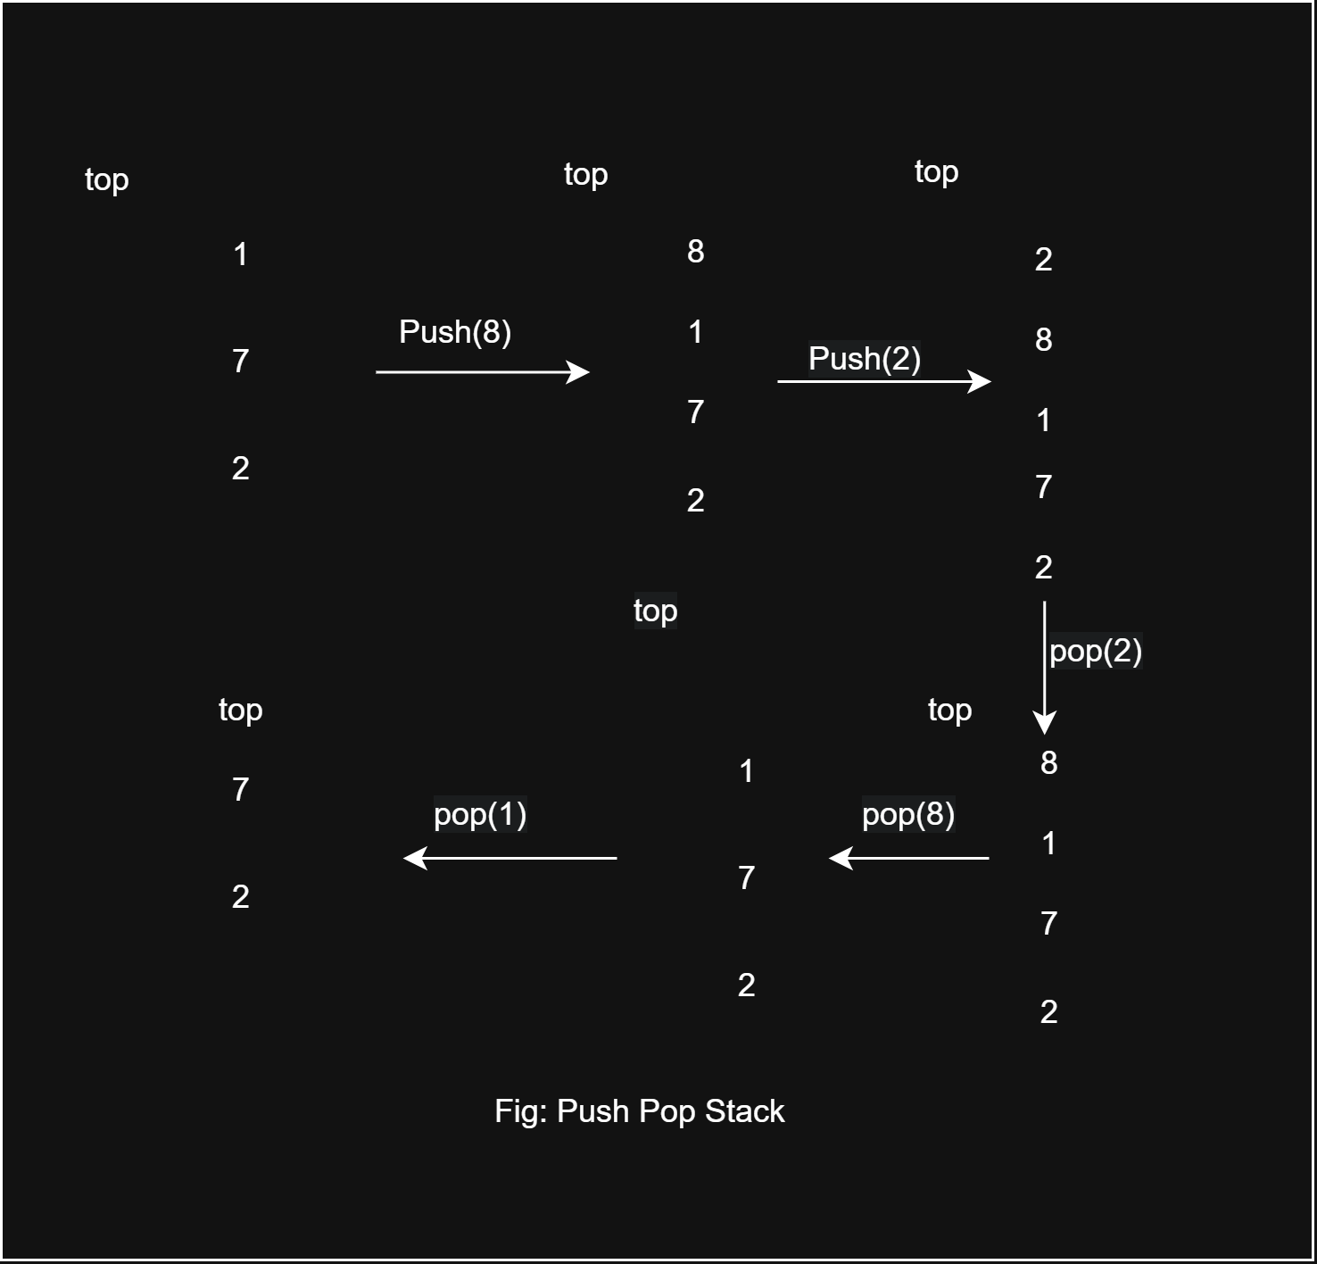
Example

Slide 5

Stack Overflow and Underflow
Stack Overflow: Pushing to a full stack
Stack Underflow: Popping from an empty stack
Array Implementation: int arr[SIZE]; int top;
Code Snippet: if (isFull()) return; and if (isEmpty()) return -1;

Slide 6
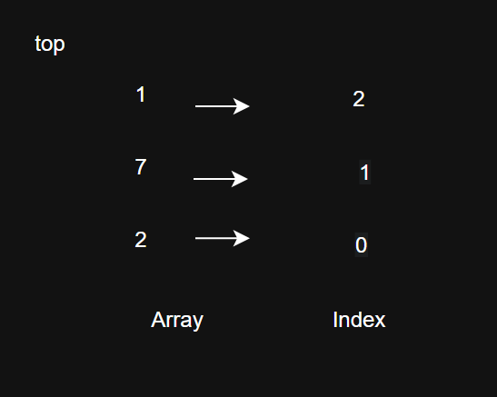
Stack Using a Static Array
A stack be implemented using a fixed size array
Example:
Int stack[3];
Capacity = 3

Slide 7
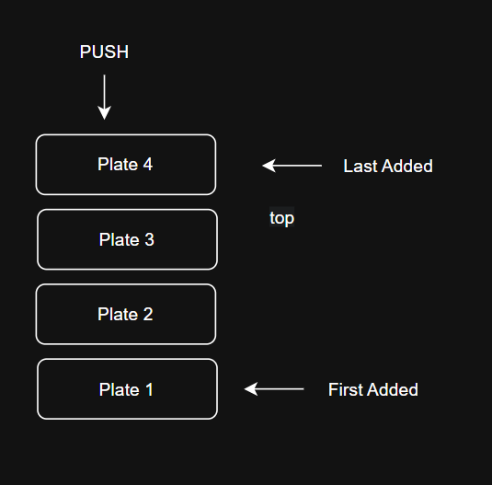
Real-Life Exaple
Image that you are in a cafeteria
Your plates on top of each other
Why LIFO: you cannot easily take Plate 1 without first removing plates 4,3,2 which are on top.

Slide 8
Advantages and Limitation of Array Based Stack
Advantages
  Simple and easy to understand and implement
  Fast Operation generally O(1)
  Memory efficient
Disadvantage
  Fixed Sized
  Possible Wasted Space
  Overflow

Slide 9
Queues
Definition: linear data structure following FIFO(First In, First Out)
Core Operations:
  Enqueue() – Add to rear
  Dequeue() - Remove from front
  Peek(): Get the element at the front of the queue without removing it.
  Isfull(): check if the queue is full.
  Isempty(): check if the queue is empty.

Slide 10
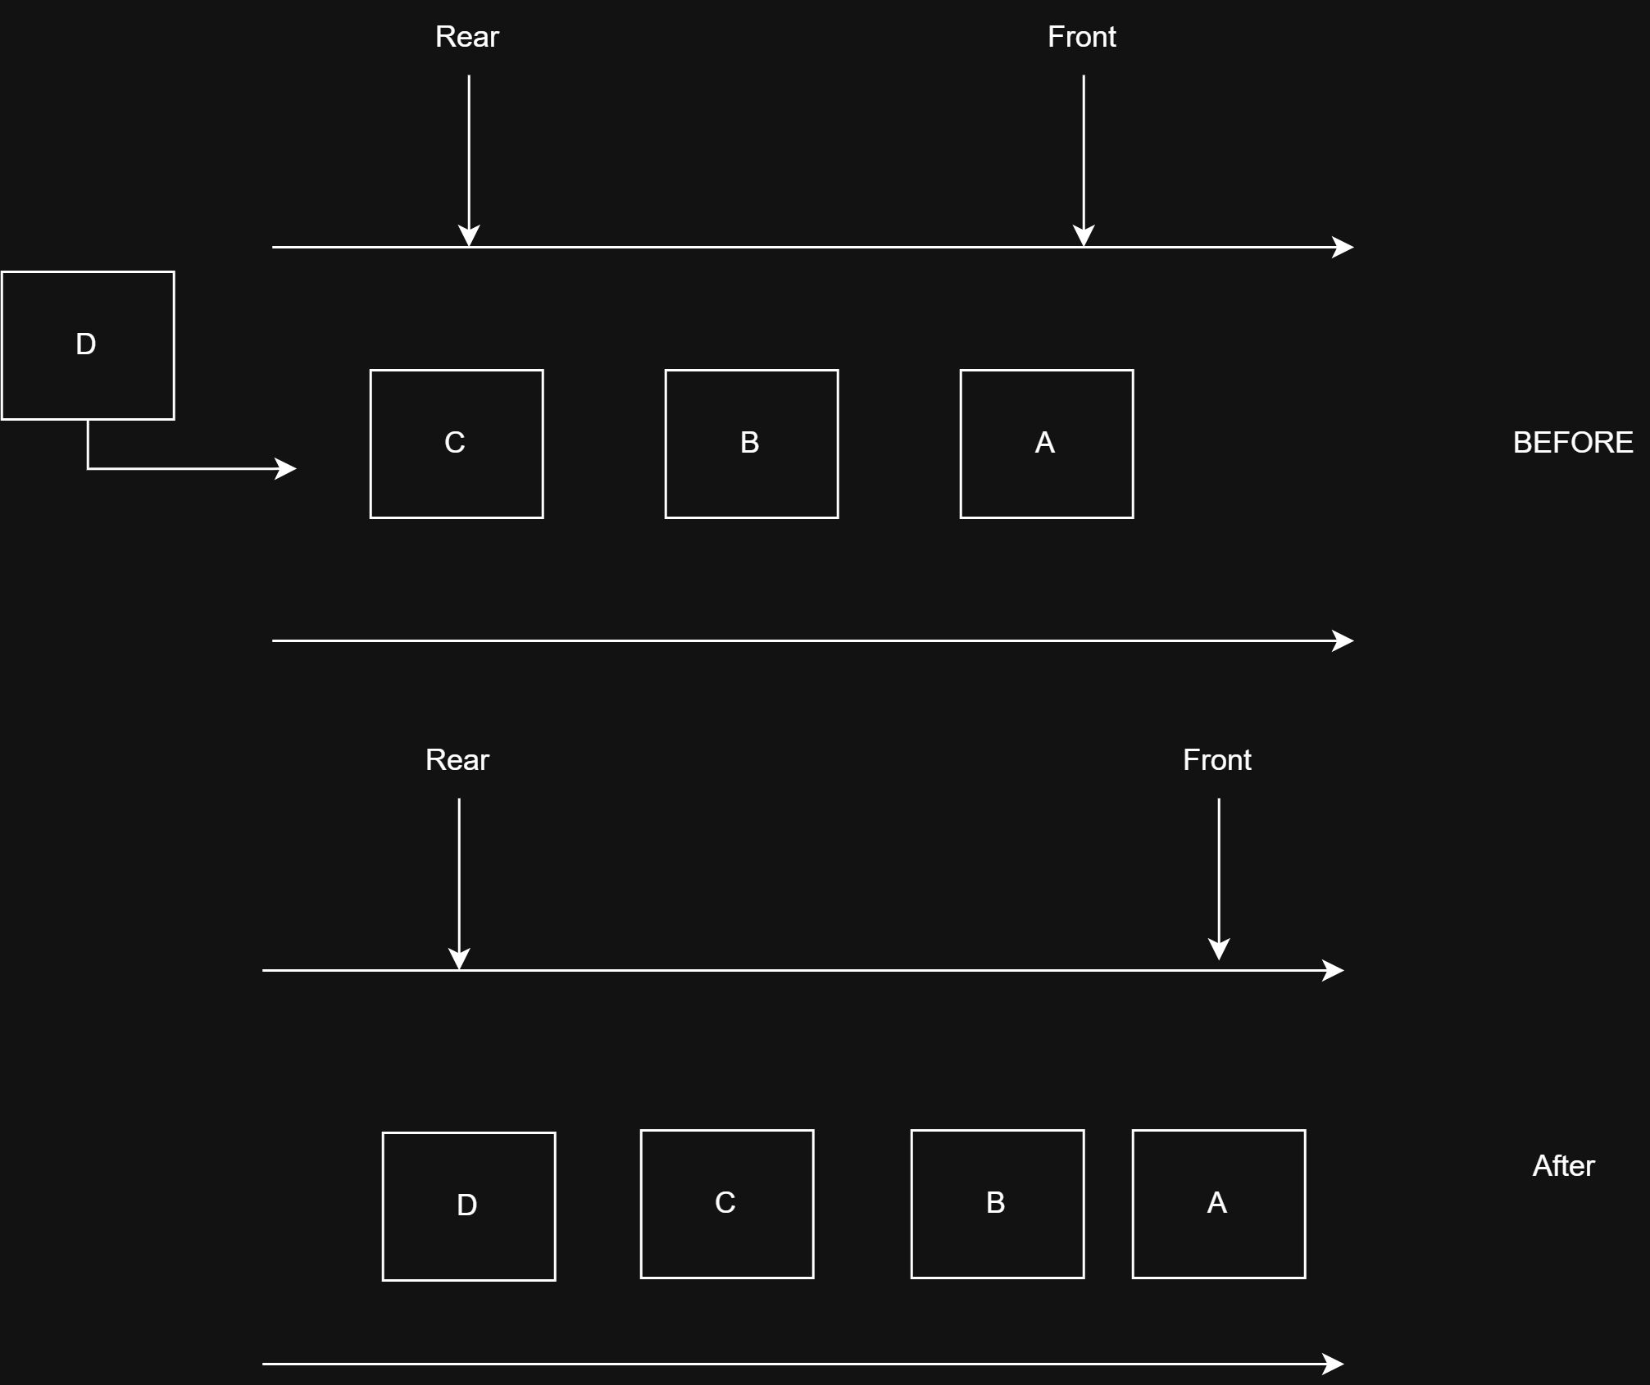
Enqueue Operation
Step 1: Check if the queue is full.
Step 2: if the queue is full, produce overflow error and exit.
Step 3: if the queue is not full, increment rear pointer to point the next empty space.
Step 4: add data element to queue location, where rear is pointing.
Step 5: return success

Slide 11
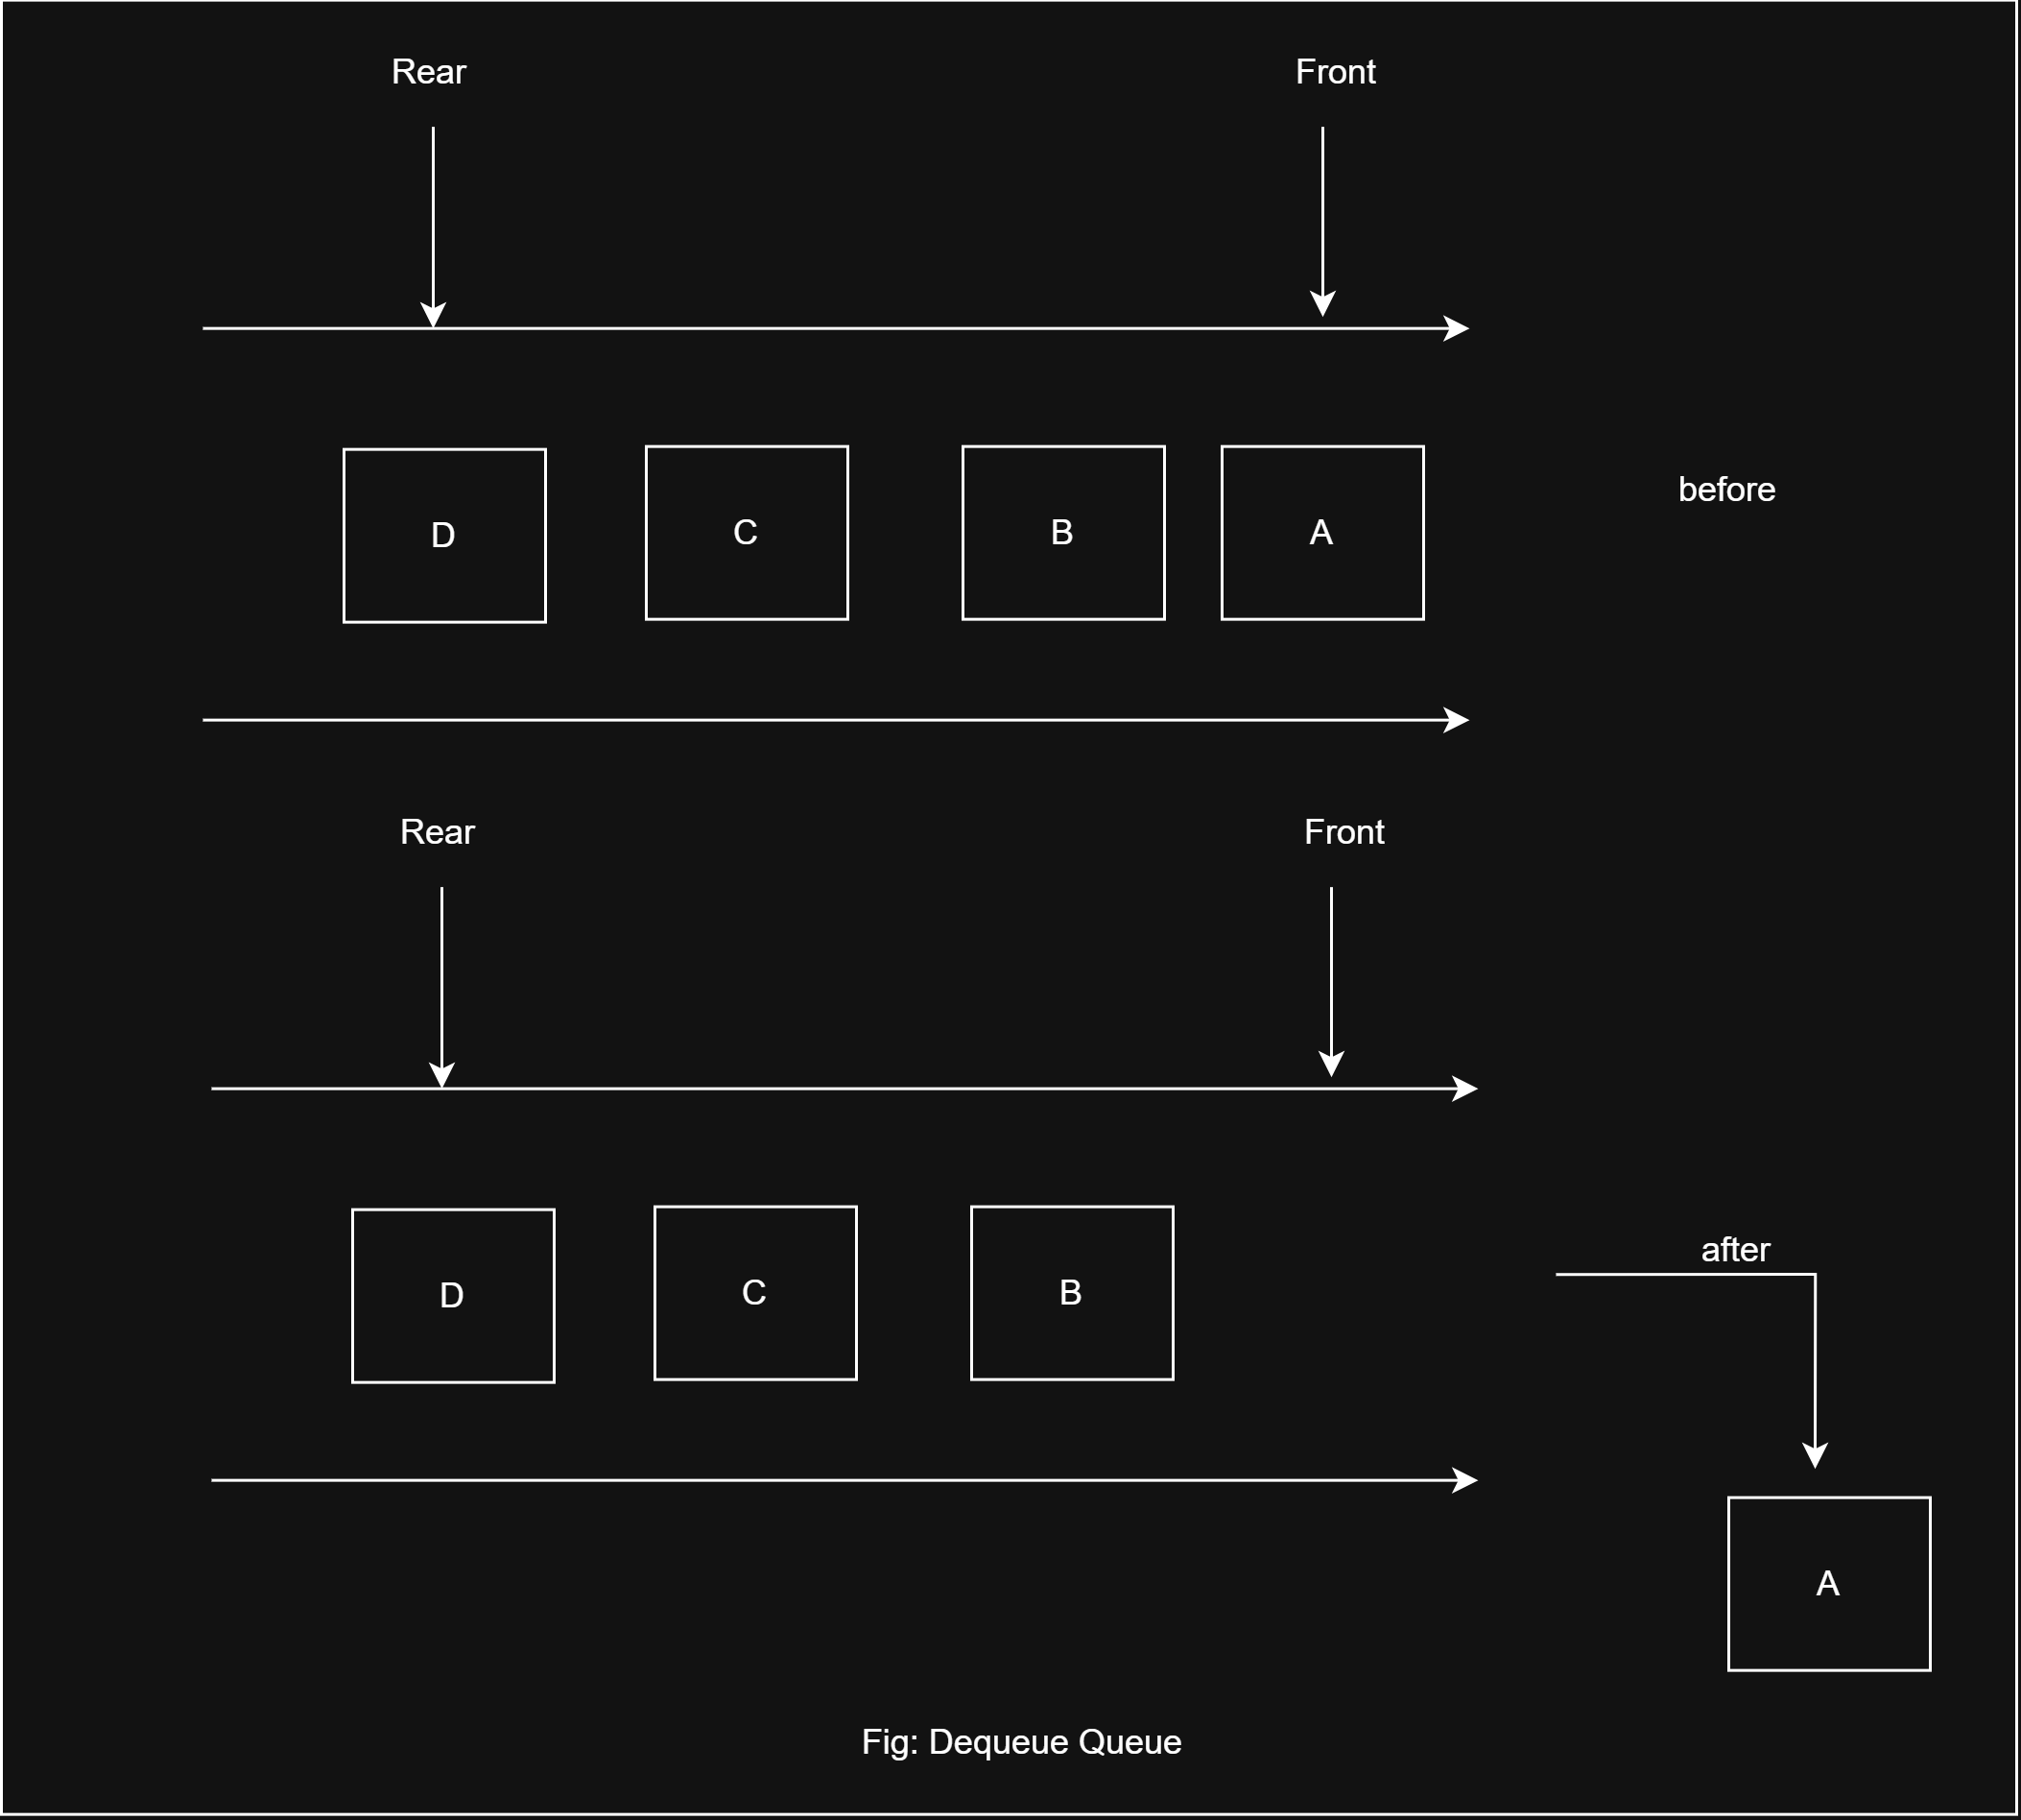
Dequeue Operation
Step 1: check if the queue is empty
Step 2: if the queue is empty, produce underflow error and exit.
Step 3: if the queue is not empty, access the data where front is pointing.
Step 4: increment front pointer to point to the next data available element.
Step 5: return success.

Slide 12
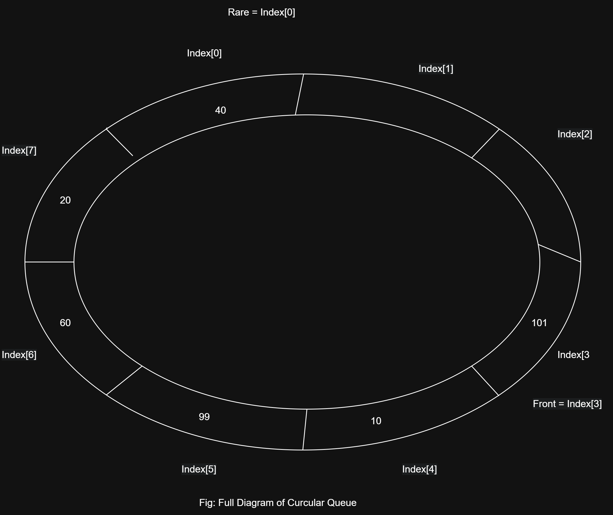
Circular Queue & Wrap-Around
Solution to linear queue problem to reuse empty spaces.
When a the rare reaches the last index, the next position become 0.
Formula: end = (end +1)%SIZE;
Variables: start,end,count.

Slide 13
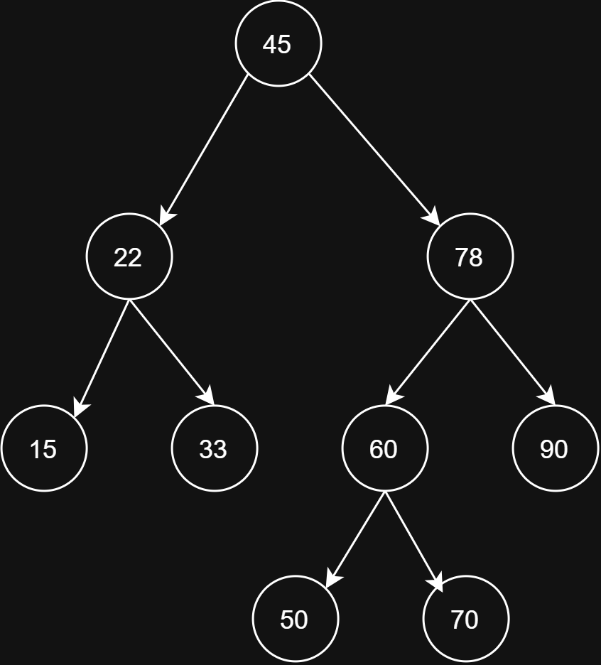
Binary Tree Fundamentals and Terminology
Non linear, hierarchical data structure
Each node has at most 2 children
Children are called left child and right child
  Node: individual element
  Root: topmost node
  Parent: node directly above another node
  Child: node directly below a parent
  Left child: child on the left
  Right child: child on the right
  Leaf: node with no children

Slide 14
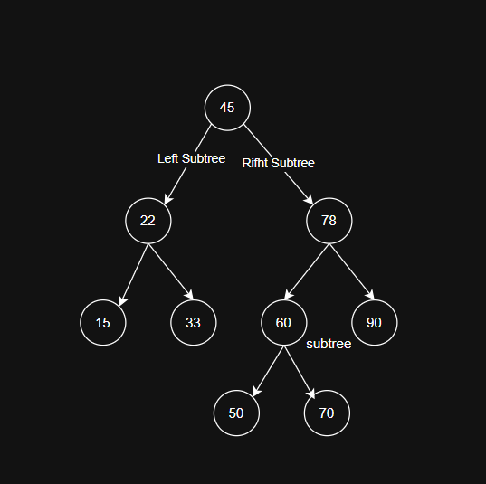
Subtree, left subtree and right subtree
Left subtree: everything below the left child
Right subtree: everything below the right child
Subtree: smaller tree withing a larger tree

Slide 15
Binary Search Tree
All elements in its left subtree are less than the node
All elements in its right subtree are greater than the node
Space complexity is O(n) as it only depends on the number of nodes in the tree
Good for applications where efficient search, insertion and detection are required like database and dictionaries.

Slide 16
Building BTS
Original Dataset:
[45,22,78,15,33,62,90,33,70,855,22,50]
Duplicates: [22,33]
Final Insertion Order
[45,22,78,15,33,60,90,70,85,50]

Slide 17
Tree traversals
Inorder:
  Formula: Left – Root – Right
  Example: 15,22,33,45,50,60,70,78,85,90
Preorder:
  Formula: Root – Left – Right
  Example: 45,22,15,33,78,60,50,70,90,85
Postorder:
  Formula: Left – Right – Root

Slide 18
Conclusion
Stack (LIFO)
queue)(FIFO)
Binary search Tree: Left < Root< Right

Slide 19


